Slide 2

FUN & LEARNING
Canpisce

Slide 3

Time Frame
8.00 to 8.10
Attendance
9.45 to 10.00
Rest Time
12.00 to 13.30
Lunch Time
15.40 to 16.00
Rest Time
15.40 to 16.00
Rest Time

Slide 4
1St Session
LAT Objectives
LEAN Principles
Just in Time
Takt Time
Pull System
Jidoka
Kiazen 3-1-3
What is LEAN ?
OUTLINE
LEAN History
Why LEAN
5 Gen’s

Slide 5
2nd Session
LEAN Tools
Value Stream MAP
Process Flow Chart
Spaghetti Diagram
Pareto
Histogram
Ishikawa Diagram, 5 whys analysis
Brainstorming
Poka Yoke
SMED
Kanban
Visual Control
Ergonomic Principles
Standard Work
Control Mechanism
OUTLINE

Slide 6
1st Session
LAT OBJECTIVE
Understand LEAN Principal
Knowing the benefits of LEAN
Able to run Kiazen effectively
Apply LEAN Tools Appropriately
Canpisce

Slide 7

Learning Together
Key To Success
We DO Know What we Know
LEAD
DIRECT
GUIDE
We DO Know What we Know
We Know What we Know
Learn
We Know What we Know
Coaching Mentoring
Observe/Exposure
We Know What we Don’t Know
We Don’t’ Know What we Don’t Know
We Don’t’ Know What we Don’t Know

Slide 8

Give a MAN a FISH, and you feed him for a day
Show him how to catch a fish, and you feed him for a lifetime.

Slide 9




LEAN Integration into Operation
Operation Lean Leader Lead the dedicated PEOPLE (vital view)
to drive employee (All) continuously with Lean approach
LEAN
Daily Management approach for managing
Operation Activities Performance
6S Approach
JDI Approach
We Are Here
Kaizen 3-1-3
TPM Approach
Current Condition

Slide 10

Operation Performance
LEAN TRANFORMATION
LEAN Leader Characteristics
Kaizen Team Competency
Leadership Characteristics
Technical Knowledge Skills Set
Lean Knowledge Experience
Kaizen Operation Performance
Leader to practice LEAN and be a coach
Technical know how on process Not just what happen
Individual Coach competency to drive Lean concept to Applications

Slide 11
1st Session
What is LEAN ?
Create Value for Customer Eliminate MUDA (Waste)
Canpisce

Slide 12
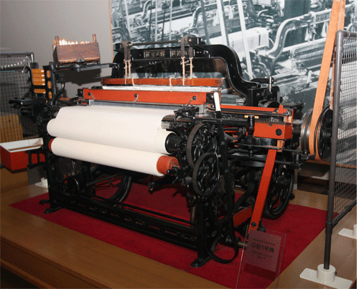
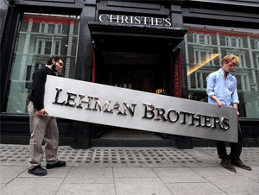

LEAN History
Taiichi Ohno organizes group to tech TPS to
Supplier
Shingeo Shingo advises Toyota on setup Time reduction
Supermarket System
Toyota suffers Losses following the Lehman Brothers collapse
Just in Time
Sakichi Toyoda invents Toyoda model G Automatic Loom
PULL System Established
1900
1950
2000
Kiichiro Toyoda
Founds Toyota Motor Corporation
Toyota lays off 1,600 workers narrowly avoiding
Bankruptcy
KICHIRO TOYODA RESIGNS
1st Arab Oil Embargo
Former Ohno disciples
Begin consulting
In USA
Toyota suffers massive loss of customer trust due to safety problems
Toyoda Automatic Loom patented with JIDOKA Mechanism
Shingeo Shingo
Visits USA
Eiji Toyoda visits
Ford Plant
at Rounge River
AKIO Toyoda announces
TOYOTA GLOBAL VISION

Slide 13
LEAN Definition
" A systematic approach to identity and eliminating waste (Non-Value added Activities) , while providing Product or Services based on customer request (Pull System), through KAIZEN , in pursuing toward perfection."
MEP LEAN Network

Slide 14






Why Need LEAN
TRADITIONAL APPROACH
LEAN APRROACH
Price
Cost
Profit
Profit
Price
Cost

Slide 15

Why Need LEAN
PRICE
USD500
Production Cost
USD 300
Profit
USD200
TRADITIONAL APPROACH
HOW ?
PRICE
USD300
Production Cost
USD 300
Profit USD 0
LEAN
APPROACH
PROFIT
USD200
PRICE
USD300
PRODUCTION COST
USD100

Slide 16
Why Need LEAN
TRADITIONAL APPROACH
LEAN APRROACH
Price
Cost
Profit
Profit
Price
Cost

Slide 17
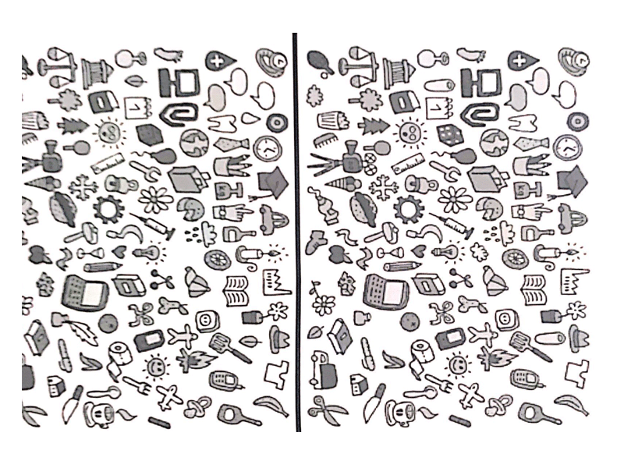
Finding
the Difference
in 10 Mins

Slide 18
What the Sensei Say……
“Genchi Genbutsu”
GO See
Part of Daily Management ‘s Important Focus

Slide 19
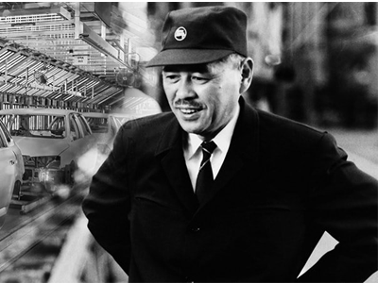
“DATA from the report is Important, but I put more emphasis on the facts looking myself”
-Taiichi ohno

Slide 20
5 Gen’s
Look at the “Actual Thing”
Use the
“Actual Theory /Knowledge”
GENBUTSU
GENRI
GENBA
GENJITSU
GENSOKU
Go to the “Actual Price”
Find the
“Actual Fact”
Understand the “Actual Current Standard”

Slide 21

Go to Paper Machine -2
Analyze at the defective Paper roll Produced
EXAMPLE
See the Actual Machine Setting
Understand and Apply the Paper Production theory
Paper Roll Wrinkles
(Defect)
Know the Rules /SOPs used for setting Paper Machines

Slide 22


GENCHI GENBUTSU
GENBA WALK
observe
NOT JUST WALK !!!!
NORMAL
ABNORMAL
IMPROVE
ROOT CAUSE
ACTION

Slide 23
GENCHI GENBUTSU
GENBA WALK
observe
NOT JUST WALK !!!!
NORMAL
ABNORMAL
IMPROVE
ROOT CAUSE
ACTION

Slide 24

WHAT Aspect to Focus ?
Motion
Safety
Unsafe conditions and unsafe behavior
Inventory
M
U
D
A
Performance
The Practice deviates from the currently defined standard (SOP/WI/SW)
Waiting
MUDA
Practice with 7 Waste of Waste (Time wood)
Defects
Revise SOP/WI/SW if applicable
Create SOP/WI/SW if not available
Overproduction
Transportation
Over processing

Slide 25




What Aspects to Focus ?
MAN
Daily Activities : Look
MATERIAL
What are kept or stored : Look
MACHINE
Operating Performance : Heard, Look, Smell, Feel
METHOD
Any Activities by man, Machine, Equipment Look
MOTHER NATURAL (ENVIRONMENT)
Actual or Potential impact to Surrounding : Look, Smell
MEASUREMENT
What Should be the Target : Look

Slide 26
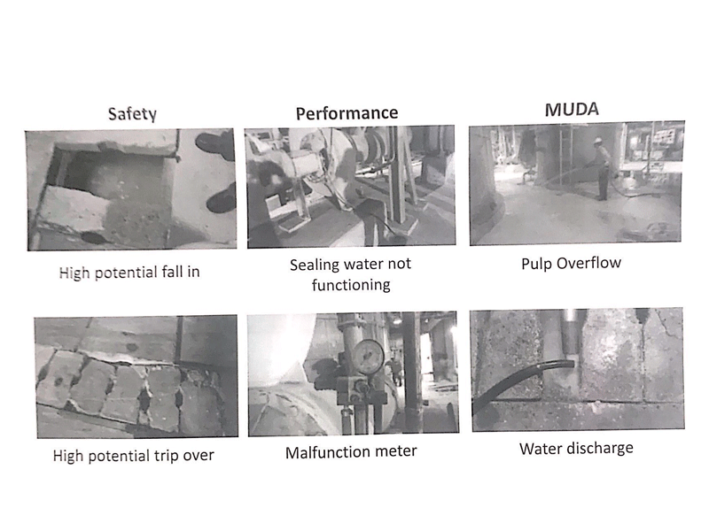
EXAMPLE
SAFETY
PERFORMANCE
MUDA
High Potential fall in
Sealing water not functioning
Pump overflow
High Potential Trip Over
Malfunction Meter
Water Discharge

Slide 27

CREATE VALUES FOR CUSTOMERS
What is Value
Value is the product /Service specification required by the customer that they willing to pay for their intended to use
Value activity
Process activity carried out by a person or machine, through changing the form or function of the product /service that meet what is needed by the customers

Slide 28

Activities Category
Non Value Added Activates - WASTE (MUDA)
Value Enabler Activates -Needed for internally
Value Added Activates - Needed for Customers

Slide 29
7 MUDA (Wastes)
Value Added
Waiting
Over
processing
Motion
Defects
Inventory
Overproduction
Transportation
Locally and Globally ordinary organizations contain at least 70% waste in their business
What is Our level of MUDA?

Slide 30

MUDA of Transportation
Transactional
Paper-based data transfer instead of Electronic.
Inter-Office Mail routing for unnecessary approvals /Processing.
Operational
Forklifts, Conveyors Long travel distance unplanned premium freight
Large batch containers.
That is caused by the process of transporting /moving goods / materials
in a process using a vehicle that does not help provide the required value

Slide 31

$29
My Price is cheaper .....come and Buy Me
My Price is more expensive because My RAW Materials come from places far from the factory
$35
EXAMPLE

Slide 32

MUDA of Inventory
TRANSACTIONAL
Excessive backlog of work to be processed.
Too Much Paper to be handled processed & filled.
Operational
Making what we can instead of what customer needs.
High obsolescence & write offs
That is caused by the accumulation of excessive material with no demand, where the Materials tie up CASH(money)

Slide 33
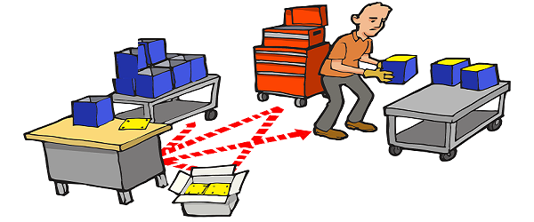
MUDA of Motion
TRASACTIONAL
Walking to deliver Paperwork,
Poor ergonomic work space,
Chasing needed information or Data
OPERATIONAL
Repetitive and unnecessary movement of parts and people caused by poor ergonomic design
That is caused by the movement of the human body which does not add
value to the Raw materials in the process of becoming finished goods

Slide 34
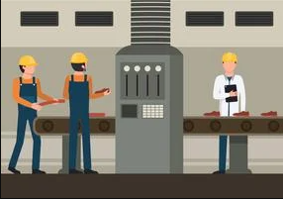
MUDA of Waiting
Time spent with no activity at all on the material & Transaction
TRANSACTIONS
Waiting for meeting to start
Waiting for information, paper works, approvals
OPERATIONS
Waiting for machines to cycle,
Waiting for materials & tools
This type of MUDA is the most happening because it is not visible in plain sight

Slide 35

MUDA for Overproduction
TRANSACTIONS
Too many reports, reviews, approvals, paperwork. Doing more than its needed
OPERATIONS
Running machines and making parts to keep the machines and people busy
To fill up machines capabilities and not customer demand
This is caused by too much production compare to market & subsequent downstream demand.

Slide 36
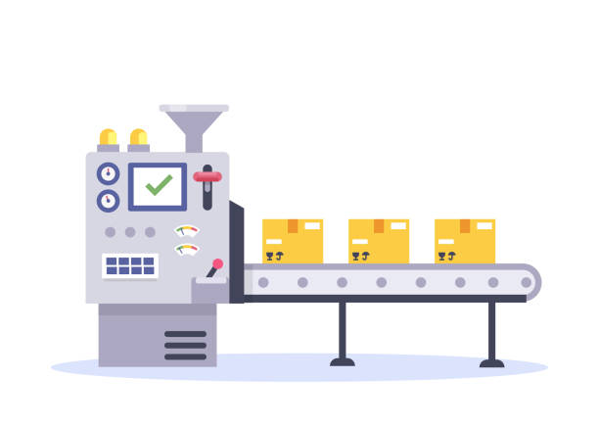

EXAMPLE
Is this Good ?

Slide 37
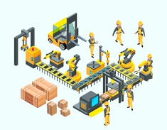
MUDA for Over processing
TRANSACTIONS
Various approvals
Multiple Checking
OPERATIONS
Incapable machines and processes.
Providing features or function not needed
Caused by excessive work steps to achieve the required result or provide what customer not needed in term of specification

Slide 38
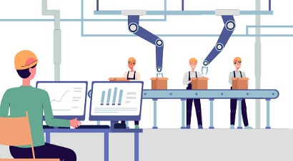
MUDA for Defect
TRANSACTIONS
Missing information
Rework, lost time, mistakes
OPERATIONS
Scrape, rework, lost capacity due to process issues, inaccurate or missing standards operating procedures.
Product or service that does Not meet customer requirements

Slide 39

New replacement only can be delivery after 1 week
Use 1
DAY……….
Example
Is This Good ?

Slide 40

Think and Write down the types MUDA Experienced at least give one Example for each category
Waiting?
Defect?
MOTION ?

Slide 41

LEAN House
R.P.S. – REG Production System
Just-in-time To make product at a time at good timing when it is sold
Operator | Standard Work | Takt Time Production
Material | Standard work in process KANBAN | One Piece Flow Supermarket
Machine | ANDON operational availability | Pull System
JIDOKA (Autonomation) Stop at every Abnormality
H E I J U N K A
Cost reduction through elimination of MUDA (Waste or Non – Value Added work)

Slide 42
Week | Total Demand
1 | 4878
2 | 3672
3 | 4536
4 | 4230
5 | 3618
6 | 4788
7 | 4464
8 | 3996
9 | 3546
10 | 4356
11 | 4536
12 | 3888
Weekly Leveled Production (4 week Leveling)
4329
4329
4329
4329
4217
4217
4217
4217
4082
4082
4082
4082
Production Levelling
Known as HEIJUNKA (Japanese), tackling High Variation production demand
Which means “Distribution of production volume and stirring evenly”
HEIJUNKA converts the inequality of pull customers into an even and predictable manufacturing process
HEIJUNKA is generally used in conjunction with other LEAN principles to stabilize the flow of values
17,316
4
4,329
16,866
4
4,217
16,326
4
4,082

Slide 43

Production Leveling
By Product Type
We Make A’s, B’s and C’s
Week
7
1
2
3
4
5
6
8
Batching
extended download for machine conversions. Worker go Home Early.
Customer waiting for Product A is tired od Waiting. Goes another Supplier.
Week
1
2
3
4
5
6
7
8
Product leveling
Conversion times are reduced and machines are flexibility tooled.
Customers are Happy with steady and Predictable flow of Product. Workers are happy with even work flow.

Slide 44
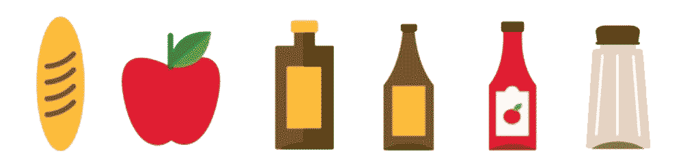
Heijunka Box
Pitch for setting the process period
Production scheduling and checking in each pitch
Product - A
Product - B
Product - C
Load Levelling Box - Heijunka Box
Product - D
Product - E
Product - F
One Column/Pitch
KANBAN card –
Qty & time to produce

Slide 45

Just-In-Time - JIT
Produce only what is needed, when it is needed, and in the right amount and right quality needed

Slide 46

Requirements for implementing JIT
Reliable equipment & Machines
Well designed work cells
Quality improvements
Standardized operations
Pull production
Single piece flow & flow at the beat of Customer

Slide 47

Borrowed from German word Taktzeit.
It's a "Production Heartbeat" with purpose is to adjust the speed of Production market Demand.
TAKT TIME
TAKT
TIME
Available Time
Total Customer Demand

Slide 48

The total time needed to complete 1 (One) series of work/Tasks from start to finish
End Goal : Cycle Time
Takt Time
CYCLE TIME

Slide 49
Example Load Chart
CYCLE TIME
What are the Abnormalities ?
What are the action ?
39
40
38
Tighten
Using Locking Nut
34
36
34
Find Assembly
32
30
28
24.1
25.3
Takt
Time
26
Put
Power
Cord
24
Quality check
22
Assembly
TIME (Second)
20
18
16
13.8
14
12
Assembly
10
6.9
8
4
2
0
Operator-1
Take body case, locking nut
Operator-2
Take back grille and tapping screw
Operator-3
Take blade and blade holder
Operator-4
Assembly
Operator-5
Take front grille & cover
Operator-6
OPERATOR

Slide 50
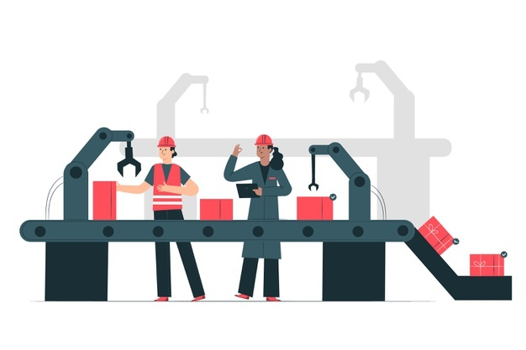



LEAD Time
Total Time required by the specific Unit to be careful from position A to Position B
Manufacturing
CYCLE TIME
A
LEAD TIME
B
Customer Request
Customer Receive

Slide 51
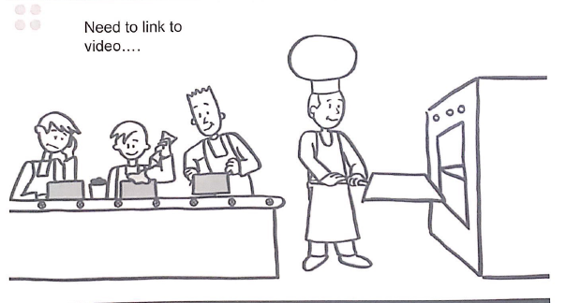
PULL System

Slide 52






PUSH System
WIP
Waiting
WIP
Raw Material
Inventory
Assembly
Turning
Waiting Receive
Production Control
Long Cycle Time
Customer

Slide 53
LEAN HOUSE
R.P.S. – REG Production System
Just-in-time To make product at a time at good timing when it is sold
Operator | Standard Work | Takt Time Production
Material | Standard work in process KANBAN | One Piece Flow Supermarket
Machine | ANDON operational availability | Pull System
JIDOKA (Autonomation) Stop at every Abnormality
H E I J U N K A
Cost reduction through elimination of MUDA (Waste or Non – Value Added work)

Slide 54
Week | Total Demand
1 | 4878
2 | 3672
3 | 4536
4 | 4230
5 | 3618
6 | 4788
7 | 4464
8 | 3996
9 | 3546
10 | 4356
11 | 4536
12 | 3888
Weekly Leveled Production (4 week Leveling)
4329
4329
4329
4329
4217
4217
4217
4217
4082
4082
4082
4082
Production Levelling
Known as HEIJUNKA (Japanese), tackling High Variation production demand
Which means “Distribution of production volume and stirring evenly”
HEIJUNKA converts the inequality of pull customers into an even and predictable manufacturing process
HEIJUNKA is generally used in conjunction with other LEAN principles to stabilize the flow of values
17,316
4
4,329
16,866
4
4,217
16,326
4
4,082

Slide 55
PRODUCTION LEVELING
By Product Type
We Make A’s, B’s and C’s
Week
7
1
2
3
4
5
6
8
Batching
extended download for machine conversions. Worker go Home Early.
Customer waiting for Product A is tired od Waiting. Goes another Supplier.
Week
1
2
3
4
5
6
7
8
Product leveling
Conversion times are reduced and machines are flexibility tooled.
Customers are Happy with steady and Predictable flow of Product. Workers are happy with even work flow.

Slide 56
HEIJUNKA BOX
Pitch for setting the process period
Production scheduling and checking in each pitch
Product - A
Product - B
Product - C
Load Levelling Box - Heijunka Box
Product - D
Product - E
Product - F
One Column/Pitch
KANBAN card –
Qty & time to produce

Slide 57
Just-In-Time - JIT
Produce only what is needed, when it is needed, and in the right amount and right quality needed

Slide 58
REQUIREMENTS FOR IMPLEMENTING JIT
Reliable equipment & Machines
Well designed work cells
Quality improvements
Standardized operations
Pull production
Single piece flow & flow at the beat of Customer

Slide 59
Borrowed from German word Taktzeit.
It's a "Production Heartbeat" with purpose is to adjust the speed of Production market Demand.
TAKT TIME
TAKT
TIME
Available Time
Total Customer Demand

Slide 60
The total time needed to complete 1 (One) series of work/Tasks from start to finish
End Goal : Cycle Time
Takt Time
CYCLE TIME

Slide 61
EXAMPLE LOAD CHART
CYCLE TIME
What are the Abnormalities ?
What are the action ?
39
40
38
Tighten
Using Locking Nut
34
36
34
Find Assembly
32
30
28
24.1
25.3
Takt
Time
26
Put
Power
Cord
24
Quality check
22
Assembly
TIME (Second)
20
18
16
13.8
14
12
Assembly
10
6.9
8
4
2
0
Operator-1
Take body case, locking nut
Operator-2
Take back grille and tapping screw
Operator-3
Take blade and blade holder
Operator-4
Assembly
Operator-5
Take front grille & cover
Operator-6
OPERATOR

Slide 62
LEAD TIME
Total Time required by the specific Unit to be careful from position A to Position B
Manufacturing
CYCLE TIME
A
LEAD TIME
B
Customer Request
Customer Receive

Slide 63
PULL SYSTEM

Slide 64
PUSH SYSTEM
WIP
Waiting
WIP
Raw Material
Inventory
Assembly
Turning
Waiting Receive
Production Control
Long Cycle Time
Customer

Slide 65







PULL SYSTEM
Create 1 piece Flow & PULL
I need One
Here it is
Here it is
Here it is
I need One NOW
I need One
Operation -1
Operation -2
Operation -3
Operation -4
KANBAN Approach to create the PULL

Slide 66
JIDOKA
AUTONOMATION
Automation with human intelligent
自 動 化
Automation = Self moving
Human Aspect
自 働 化
JI
DOU
KA
Autonomation = Self working

Slide 67
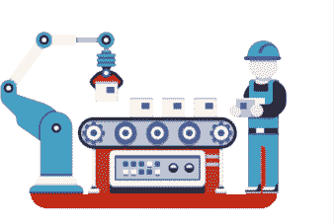
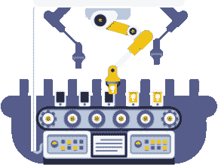

JIDOKA EVOLUTION
Andon
light
Human Intervene Repair
Automatic Feed
Automatic Feed
Automatic Ejection
Manual feed and cycle watch machine cycle
Watch machine cycle
Self –Monitoring Machine

Slide 68
自 働 化
JI
KA
DOU
OBJECTIVE
Enabling operations to build quality in every process.
SEPARATING
Separating the Activities of Human from Machine.
APPROACH
The Ability to detect and stop Immediately.

Slide 69
4 step of JIDOKA
Canpisce

Slide 70

4 STEP OF JIDOKA
Step 02
Step 04
Step 01
Step 03
Machine automatic stop, send out the signal
Human identify the root cause (observe) to derive improvement action ( for frequent repeated problem)
Human resolve the abnormalities, enable ,machine continue to work.
Machine detect abnormalities.

Slide 71
What is KAIZEN ?
改
Kai
善
Zen
Change
Good (Or Better)
Continuous Efforts to change current conditions/Practice towards perfection
If you think that every think is working as it should, you cannot do Kaizen “
Taiichi Onno, “Father of TPS (Toyota Production System)”

Slide 72
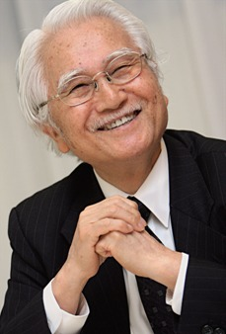
What is Kaizen ?
"The message of the Kaizen strategy is that not a day should go by without some kind of improvement being made somewhere in the company."
"Kaizen is everyday improvement, everybody improvement, everywhere improvement.
Kaizen means ongoing improvement involving everybody, without spending much money."
Masaaki Imai
Kaizen Institute, Ltd.

Slide 73
What is Kaizen ?
Kaizen does not only mean "Continuous Improvement", but Kaizen has a broad meaning , namely:
Not only that , Kaizen must be done
Self-Discipline
Commitment
Integrity
Everyday
Everybody
Everywhere
Start with me (Starting with yourself)

Slide 74


What is Kaizen ?
Although Kaizen is done on the ground, Kaizen must be started by the managers, because they need to lead & Coach as
Kaizen is not only done by Production or Engineering /Maintenance employee , but Kaizen is
THE WHOLE COMPANY
LEAN LEADERS

Slide 75



RULES OF THUMB
Open- minded - do not blame others, but to be better together.
Efforts to find solutions to reach the targets, not efforts to find excuses why can not reach the targets.
Commitment and persistent to implement what is decided –sustainable.

Slide 76
KAIZEN MINDSET
Changes never end
Abnormalities = Opportunity to excel
Run a solution that has been determined and approved, not to wait until it is perfect

Slide 77

THINK Creatively to get solutions
"Do Not use Wallet“

Slide 78



KAIZEN FOCUS ON 3 ASPECTS
TOPICC
Direction/Approach, KPI
SOP/WI/FORM
To manage system
To manage tool
Operation Tools
Administrative Tools
to Create, apply (use) to Guide, Manage
To help To Create, Apply (Use)
Internal staff at multiple level (behavior, competence, altitude, commitment )
External contractor

Slide 79
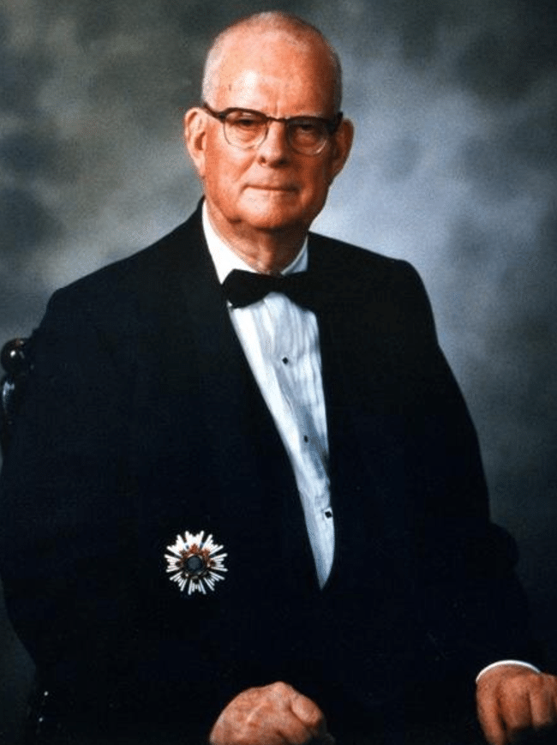
KAIZEN Focus on 3 Aspects
Teams and System Thinking
"94%" of Problems in business are systems driven and only 6% are people driven .
W. Edwards Deming
1900-1993

Slide 80
KAIZEN 3-1-3
Very Focus !!
3
Pre Kaizen
3
Post Kaizen
1 Week focus efforts to make the changes happen, achieve the Kaizen target Week of Action
Up to 3 months to ensure sustainability of Performance Weeks of Monitoring, fine tuning
3 weeks stared for the preparation.
weeks of Direction, Plan, Analyze, Narrow down
Kaizen Week
1
Very Crucial!!!
Very Essential !!

Slide 81
PCDA IN KAIZEN 3-1-3
ACT
DO
CHECK
IDENTIFY
Identify the opportunities
SMART A3
Current condition Understanding
Pre-Kaizen Activities: Kaizen focus approach, Gemba observation, Fishbone, LAT
Activities pace vs Takt Time setup control
Sustainability
Activation of Countermeasure of control mechanism
Prioritize focus Decision from Root cause identification
Develop Hypothesis
Test & Proven Hypothesis
Solution Decision Managing
Set New Standard (include control mechanism)
Post Kaizen Monitor include actual pace against Takt Time
Action item completion
Integration into Daily Management

Slide 82



PDCA IN KAIZEN 3-1-3
Kaizen at a Glance
PREP
STEP-1
STEP-2
STEP-3
STEP-4
FOLLOW THROUGH
PROFILE BIG IDEA
TARGET SHEET
POST & REVIEW
STANDARDS WORK
OBSERVE
TRY STORM
IMPLEMENT
STANDARD WORK
Previous data
Open Eyes Open Mind
SORT ISSUE
Trail Run
For Impact A or B
Time
Space
Safety
5S
Quality
Productivity
Safety & 5S
Operator Interview
“DO ABLE” = 1 OR 2
DIVIDE & CONQUER
MAKE EXPERIMENTS
COMPARE RESULTS TO TARGET MEASURES
Compare Results
Over & Over
Make Adjustments
LOOK FOR BEST
LEAST WASTE
SURE QUALITY
MOST VISIBLE
SAFETY
LEVEL”EST” WAY
Post & Review
Standards Work
Finish – address
Open Action Items
Check for Drift
Select Next
Make Output Chart
SPAGHETTI MAP
Plan
Actual
Set up Comment loop
List of Supplies
TIME
IDEA FOR IMPROVEMENT
Parteo
Tool Box
Forms
Rules
Snacks
TIME LINE
Stuck
Ask 7 ways
Catalyst
Matrix
Kaizen News paper
Open Action Item
Identify waste
Raise Issue
Ask why 5 times
Profile Big Idea
Target Sheet
PRACTICE FINAL PRESENTATION
COMMUNICATION
KICKOFF
BURNING QUESTIONS
REPORTS OUT
OPTIONAL TODAY ONLY
WHAT WE DID WHAT’S NEXT FEEDBACK
SHOW & TELL PROPOSED STD. WORK
FINAL PRESENTATION
CELEBRATE
Review Status

Slide 83
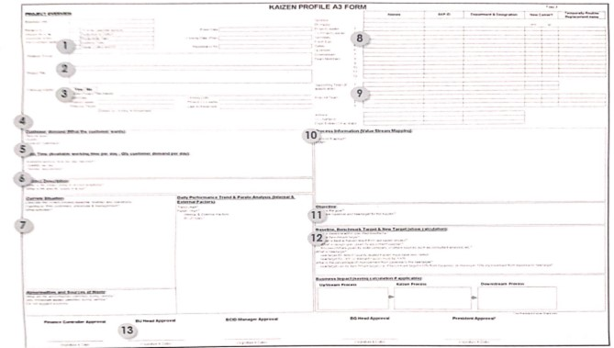
A3 FORM

Slide 84
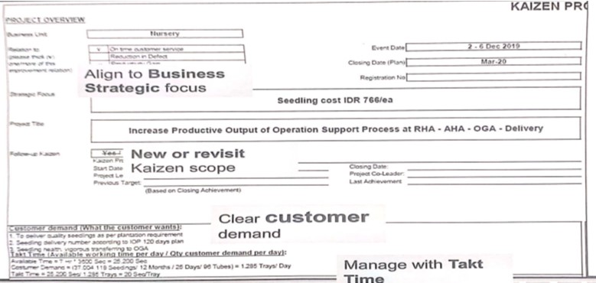
A3 FORM

Slide 85
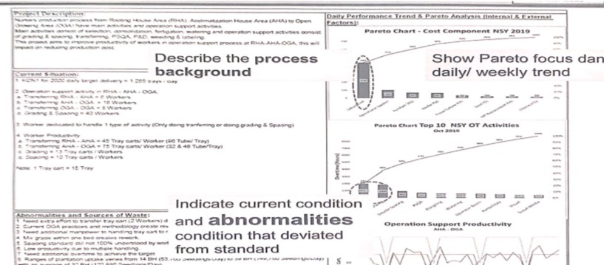
A3 FORM

Slide 86
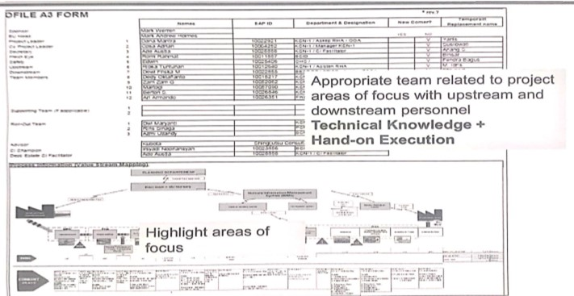
A3 FORM

Slide 87
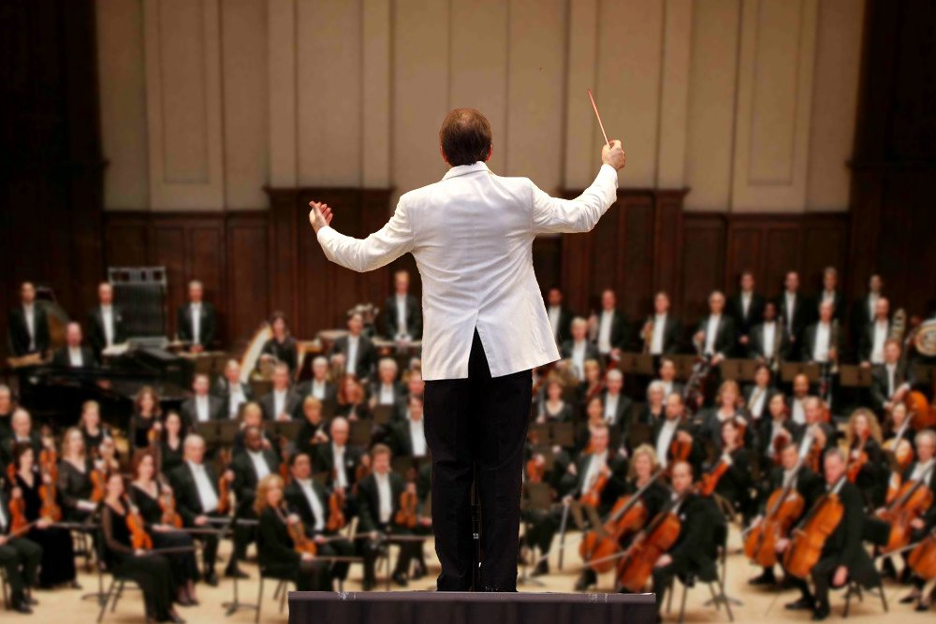



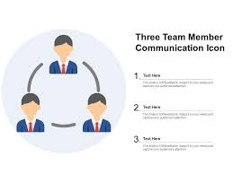
Roles and Responsibility
Leader and Drive
Lead and Drive
Secretary
Consolidate, analyze and highlight
Fresh eyes
Challenge at different perception
Team Member
Pro-active focus engagement

Slide 88

Don’t focus executive specific action, allocate time to focus route going around
Each Kaizen sub team
Align Kaizen team direction
Guide Kaizen team action
Provide the decision
Motivate Kaizen team
Driving Kaizen team engagement at all time !!

Slide 89
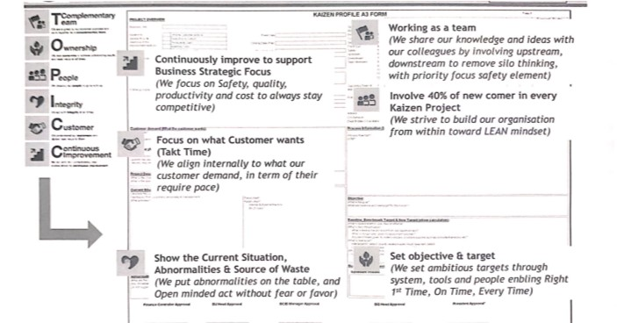
A3 FORM

Slide 90
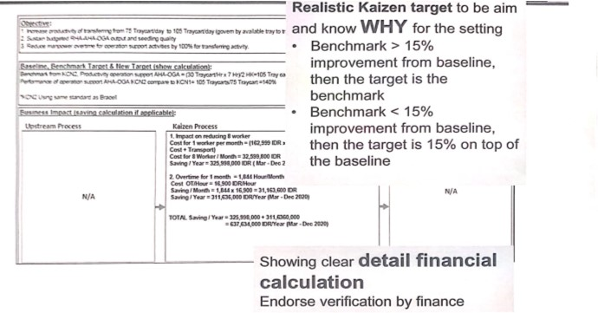
A3 FORM

Slide 91
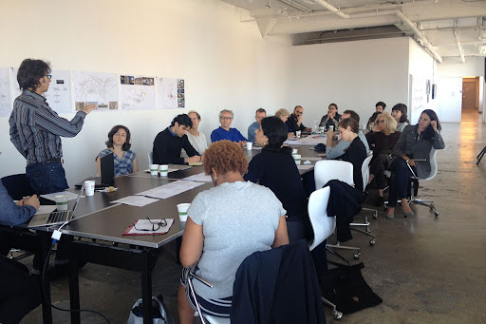
KAIZEN 3+1+3
1
A3 preparation
Understand customer demand
Decide project title and scope
Dedicate compatible person as team member
Set up baseline and target
Genba Observation, historical data analysis
Brainstorming Fishbone for understanding current situation and abnormality
Preparation of material, resource for trail
Prepare data for support problem hypothesis
2
LEAN awareness training
Pre Kaizen Activity
3
Kaizen Leader, Co-leader Enhancement (if applicable)

Slide 92

KAIZEN 3+1+3
Educated members for LEAN implementation
A3 form, abnormalities Root Cause and LEAN Solution
Draft A3 submission to Crop BCID >= 10 days before Kaizen opening
Opening Presentation
Pre Kaizen Out Put

Slide 93

Deriving the Kaizen project approach
Approach thinking (not a solution) what is needed to achieve the Kaizen project target.
Based on kaizen project’s condition / scope
The appropriate pathway will facilitate the Kaizen team – Minimize “trial and error” but systematic planning

Slide 94
Let’s Take an Example

Slide 95
INCREASE STEAM PRODUCTION 55TON /HR @ $N / TON KAIZEN APPROACH FOCUS
(Increase boiler efficiency from N to Y)
Steam supply to PM machine 55ton /hr at $N / ton (in term of volume and Quality)
Customer receive amount
Incoming material condition
SI, Biomass boiler efficiency inadequate
Measurement error validation
Steam leakage
Preparation condition
Odor, Particle release
Public reaction
What are the quality spec and what are the control to setup
Genba observation method of preparation. what are the specification and what are the deviation need to be improve
What are the burning parameter setting , material burning composition ratio and what are the control
Technical control
WHY WHY analysis on WHAT been identify (FACT, not perception )
How the material been feed into boiler?
WHAT are the Benchmarking against boiler design efficiency?
WHAT are the equipment condition?
LEAN approach solution idea
APPROACH
Process flow mapping
Post -IT-tab marking (VA,VE,NVA)
Genba analysis to observe What are the deviation against standard and hidden MUDA *
History data analysis identify the optimum setting condition
Kaizen week –week of action execution
KaiZEN efforts changes on the process, method , design , system
Trial run to be plan for KAIZEN

Slide 96
*MUDA aspect in identify abnormalities :
T How material been transfer feed
I What the impact of stock level to burning efficiency ?
M How the Material been prepare ?
W What are the material flow waiting happen or waiting of information reaction to burning process
O Steam venting respective elimination
O Over steam spec, additional step for managing incoming material
Defect Income material quality, boiler maintenance overdue, stem quality
Legend
Pre-Kaizen Week
Kaizen Week

Slide 97
Let’s Take an Example

Slide 98
REDUCE UNPLANNED DOWNTIME KAIZEN APPROACH FOCUS
2
Breakdown maintenance execution Evaluation effectiveness
Minimize
Workshop repair performance
Part
Repair plan
Management finance team procurement
1
2
Evaluation effectiveness
Evolution effectiveness
Breakdown data analysis (LPR)
Tool and part availability and quality
1
PVM-Predictive
Maintenance
PVM-Periodic
Maintenance Plan
Calibration flow
Store accuracy and storage condition
On the run planning Execution
Shut planning execution
Corrective Maintenance execution (NOT) just fixing, but improve )
Part
1
Evolution effectiveness
Evolution effectiveness
Evolution effectiveness
Min Max analysis
optimize
Skill matrix
Training
“Troubleshooting
Maintenance”
1

Slide 99
KAIZEN 3+1+3
Time | Day 1 | Day2 | Day 3 | Day 4 | Day5
8.00 am | Team pre ready | Recap briefing | Recap briefing | Recap briefing | Team Pre Ready
10.00 am | Kaizen event week opening presentation | Data analysis Solution Plan execution , Monitoring | Data Analysis Solution plan execution. Monitoring | Solution plan execution monitoring | Final presentation
12.00pm | Lunch Break
1.30 pm 3.00 pm | 1. kaizen approach sharing 2. VSM /process map/ Flow Chart /Block diagram focus discussion 3. Gemba walk observation focus | 1. Data Analysis 2. Solution Plan execution monitoring 3. Standard draft (Flow Chart) Action tasks list slide update | 1. Data Analysis 2. Solution plan execution Monitoring 3. Standard draft (Flow Chart) Action tasks list Slide update | 1. Solution plan execution Monitoring 2. Standardization 3. Control Mechanism Action tasks list , Slide update | Post Kaizen Plan integration into DM
4.00 pm | 4.Fishbone /WHY –WHY
 | Analysis finalization Solution Plan discussion | Kaizen leader meeting
A
C
D
B
E
Plan and Share with team what and approach and why.
Must adequate been done to the actual root cause.
What are the action to ensure standard in place or what countermeasure action if Standard derive deviated?
Include all known action require to be focus in Post Kaizen
Knowing how to presenting the team efforts.

Slide 100










KAIZEN 3+1+3
MON
Opening presentation (Morning)
Finalize the analysis and focus to be execute
GENBA with validation
TUES & WED
Conduct Trial
Update Action Plan
Leader’s Meeting (direction input sharing
THURS
Prepare closing presentation
Action List
Standardize
Continue with action
Result tracking
FRI
Final Presentation

Slide 101
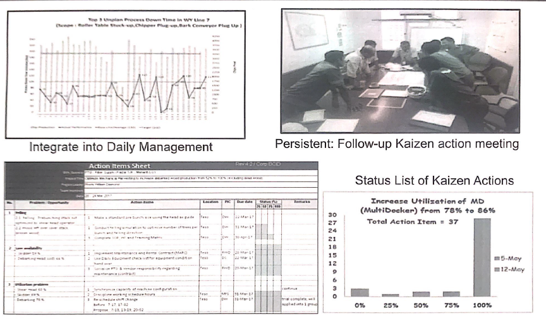
KAIZEN 3+1+3
Integrate into Daily Management
Persistent : Follow-up Kaizen action meeting
Status List of Kaizen Actions

Slide 102
LEAN Tool
Gemba & Observation
Poka Yoke
KANBAN
Ergonomics principle
Analysis & Verification
2
1
SMED
Standard Work
Control Mechanism
Process Flow Chart
Histogram
Brain Storming
Visual Control
Pareto
Spaghetti Diagram
Value stream mapping
Ishikawa Diagram
Improvement Approach
3
4
Standardization

Slide 103
VALUE STEAM MAP
Is a method for describing the whole set of activity process
Starting from receiving an order/order for a product services, from the customer
Until delivery to customers in the form of finished goods /information

Slide 104
VALUE STEAM MAP FUNCTION
To identify which arear will focus based on a longest process time
to find out how the movement of information causes material , in terms of triggering and monitoring
to show the relationship and impact from the supplier to the customer

Slide 105
COMPONENT
OBJECTIVE
1
Product /Service Process
Process flow
Value
Steam
Map
Component
Material movement, configuration , WIP
Material flow
2
Enabling material flow : What , How, When Triggering
3
Information Flow
Details breakdown require in reflecting process current condition
Data Box
4

Slide 106





VALUE STREAM MAP COMPONENT
Production Controller
MRP
90/60/30 day Forecast
Daily Order
6 Weeks Forecast
Information flow
Supplier
Central Controller
Customers
Tues. Thurs
Weekly Schedule
A
B
C
D
E
SHIPPING
I
I
I
I
I
I
STAGING
Coins
5 Days
C/T = 10 sec
C/T = 39 sec
C/T = 46 sec
C/T = 62 sec
C/T = 40 sec
C/D = 1 hour
C/D = 10 mins.
C/D = 10 mins.
C/D = 0 mins.
C/D = 0 mins.
DATA BOX
Uptime = B5%
Uptime = 100%
Uptime = 80%
Uptime = 100%
Uptime = 100%
27,600 sec avail
27,600 sec avail
27,600 sec avail
27,600 sec avail
27,600 sec avail
EPE = 2 Weeks
2 shifts
2 shifts
2 shifts
2 shifts
5 Days
7.6 days
1.8 days
2.7 days
4.5 Days
Production LT= 23.6 days
39 Sec
42 Sec
62 Sec
KAIZEN Brust
40 Sec
Processing time =188 Sec
1 Sec
NAV time
VA time

Slide 107

PROCESS FLOW
Is a Picture of Steps that are separate from a sequential work process.

Slide 108
3 VERSION OF PROCESS FLOW
In any activities scope, there are 3 version of process flow
What you Think
What it Actually is
What it should

Slide 109
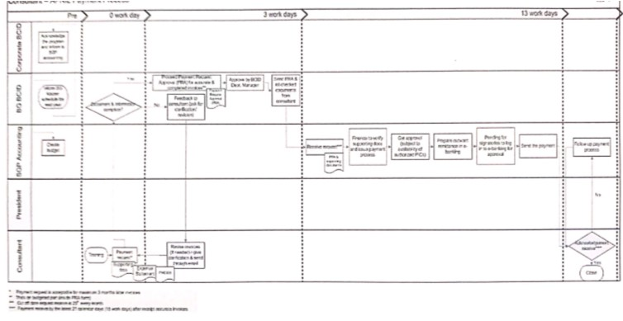
SWIMLANE PROCESS FLOW

Slide 110
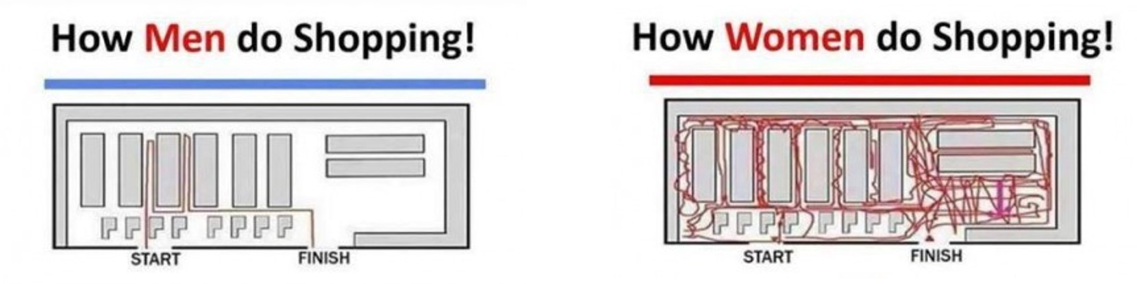
SPAGHETTI DIAGRAM
It's a continuous flow line that use to identify redundancies in the work flow
To analyze and optimize the distances. the benefit can be either faster delivery or the same
delivery or the same delivery with less effort.

Slide 111
SPAGHETTI DIAGRAM
Items to include in spaghetti diagram
layout & Work elements
Distance
Abnormalities

Slide 112
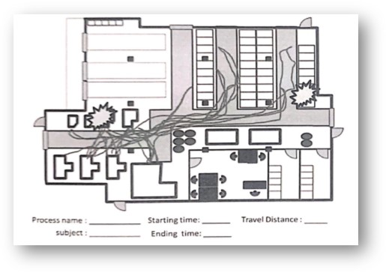
Spaghetti Diagram
Determine study area /Object
Get a color pen & layout of the area (prefer black & white)
Get consensus of the people observed /representative
follow the person on his daily work
record down starting time, ending time , abnormalities , travel .distance
Conduct analysis 7 come out idea for improvement

Slide 113
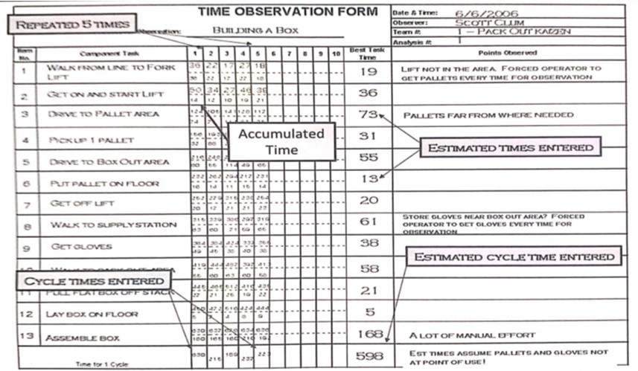
TIME STUDY

Slide 114
A Pareto chart, named after Vilfredo Pareto, is a type of chart that contains both bars and a line graph, where individual values are represented on descending order by bars, and the cumulative total is represented by the line.
PARETO (80:20)
What is Pareto Chart ?

Slide 115
When analysis data about the frequency of problems or causes in a process.
When there are many problem or causes and you want to focus on the most significant (80.20 Rules)
When communicating with others about your data.
PARETO (80:20)
Where to Use ?

Slide 116
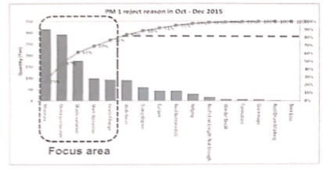
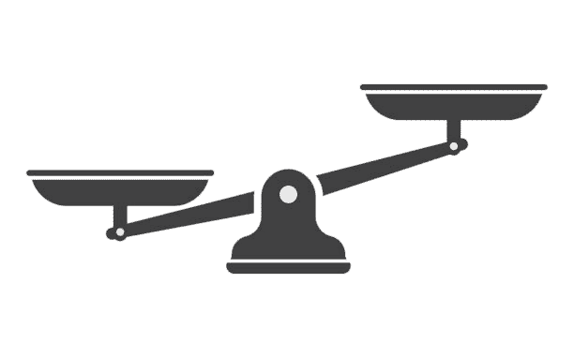
PARETO (80:20)
Decide what categories to group the items
Decide what measurement is appropriate eg. Frequency , Quality , Cost ,time etc
Decide what period of time the pareto chart will cover e.g Day, week , month
Collect data & sum up the measurement, calculate the percentage
Construct bars chart (from tallest to lowest)
Draw 2nd axis on accumulative percentage.
80%
20%

Slide 117

BRAINSTORMING
Brainstorming combines a relaxed, Informal approach for LEAN Solution with lateral (sideway/crosswise) thinking.
It encourage people to come up with thoughts and ideas that can, at first, seem a bit crazy.
This helps to get people unstruck by “jolting” them out of their normal ways of thinking. Others can speak even more ideas.

Slide 118


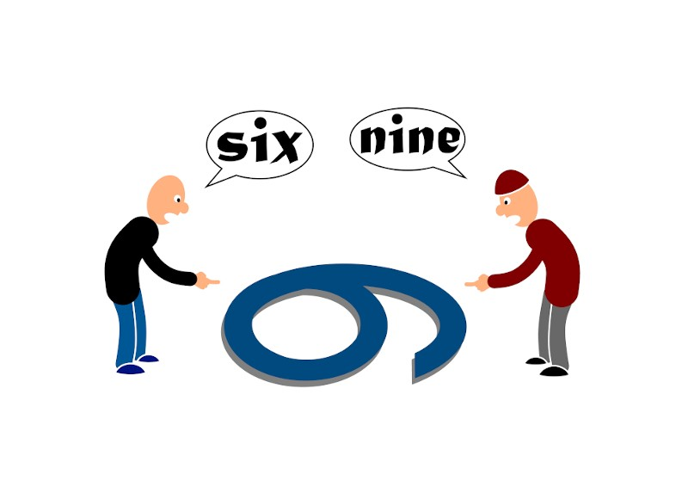
BRAINSTORMING
VS

Slide 119



SILENT BRAINSTORMING : DONE WITHOUT DISCUSSION
Tools require
Pen Marker
Post it (Various Color)
Flip Chart

Slide 120
ISHIKAWA DIAGRAM
Also name as cause & effect Diagram
The Ishikawa diagram identifies many possible. It can be used to structure a Brainstorming session.
it immediately sorts ideas into useful categories.

Slide 121
ISHIKAWA DIAGRAM+5 WHYS
Rules
Ask "Why " until it can't be asked anymore
Think about the root cause first , don't discuss solutions
Always focus on System Process > Tools > HUMAN
Use the statement
1st bone related to effect
MAN
WHY 1
Machine
WHY 1
WHY 3
2nd Bone reflect to 1st bone on WHY
3rd bone reflect to 2nd bone on WHY
Use the categories
Method
Measurement
Material
Mother Nature

Slide 122
WHY
WHY
WHY
Why my Tea is cold ?
Why the Boiler not heat up water ?
Why the circuit blow-up ?
Why wrong circuit been installed ?
Why the circuit specification not been determine?
Boiler not heating up the water
Not electric power, circuit blow -up
Wrong circuit been installed
Circuit require not been determine
No specification been given

Slide 123
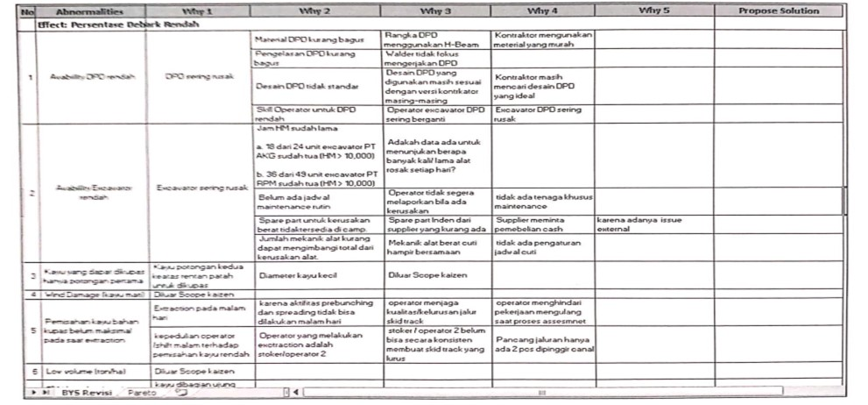
5 WHYS ANALYSIS

Slide 124

15- MINUTES EXERCISE
Why come late for training Today ?

Slide 125
POKA| YOKE
Also known as mistake proofing, its a Japanese term meaning "avoiding inadvertent
mistake", which was formalized by Shigeo Shingo in 1961.
It's methos that either prevents error to occur , or making the mistake visible or detectable once occurring.
ポカ
Mistake
POKA
ヨク
Proofing
YOKE

Slide 126
POKA| YOKE
Misidentification
Negligence
Forget
Lack of Standardization
Misunderstand
Stubborn (don’t want follow the rules )
Deliberately (sabotage )
Shocked
Lack of Experience
Lateness
Not to blame, but think about what are the solution

Slide 127
POKA| YOKE
POTENTIAL /CURRENT ABNORMALITIES
Perform root cause analysis
Can the solution become preventive
YES
NO
Prevention /Control System
Detection /Warning System

Slide 128
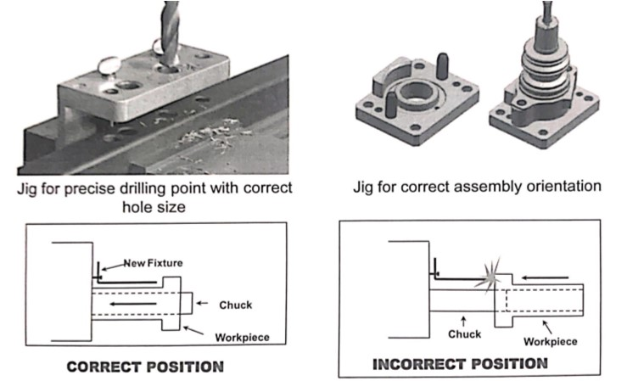
EXAMPLE FOR CONTROL SYSTEM

Slide 129
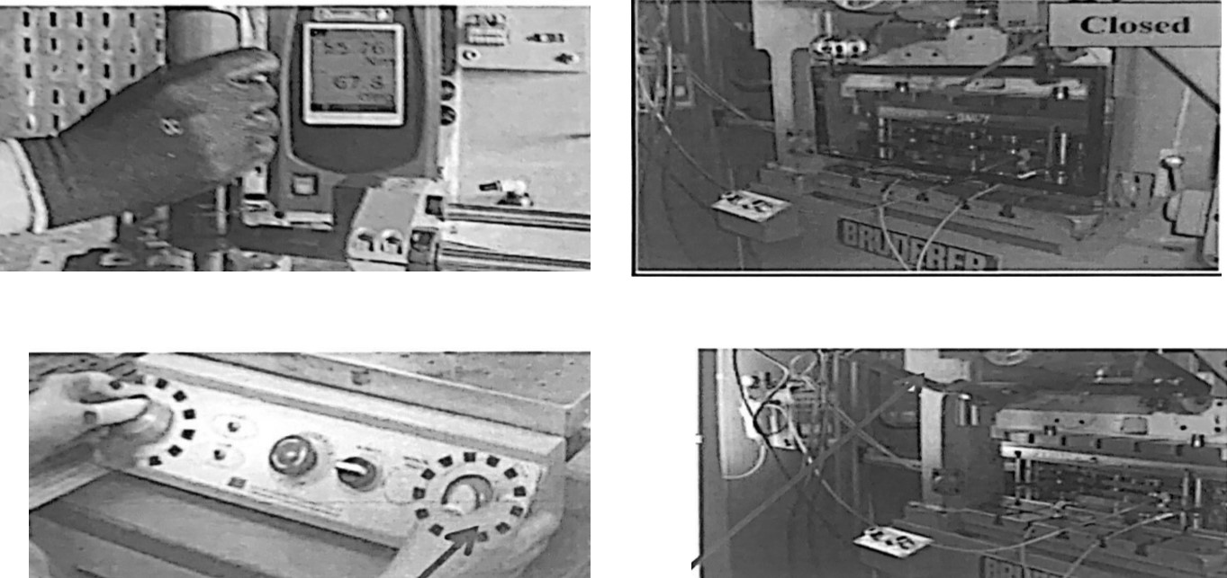
EXAMPLE FOR CONTROL SYSTEM
Smart Torque fastener to control tightening torque
Dual Palm push buttons to activate toggle press
Press cannot be activated when safety cover is opened

Slide 130

BENEFITS OF POKA YOKE
Help to prevent or detect human (or machine error jidoka)
Promote safety and incident –free in the Workplace .
Improve quality of Product output and prevent delivery of detect to the customer.
Prevent damage of machine or property
Reduce cost of rework.

Slide 131
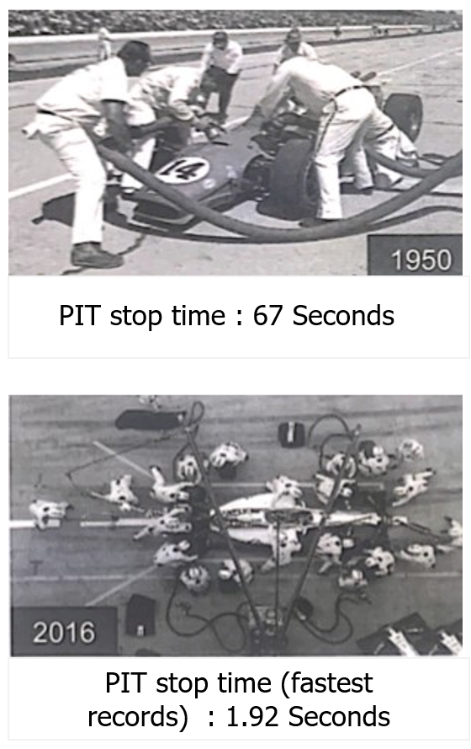
SMED
SMED (Single -Minute Exchange of Dies ) is system for dramatically reducing the time it takes to complete equipment changeovers
Single-Minute Exchange of dies comes from the goal of reducing changeover times to the "Single" digit (i.e less than 10 Minutes).

Slide 132




SMED
Last good product of RUN
First Good Product(s) of Run
Preparation
30%
Actual Setup
A
5%
B
Measurement & Setting
15%
Adjustment /Trial Runs
50%
Changeover Time
Changeover Time is the length of time from the last good product of a production run to the first good product(s) of the next production run

Slide 133
SMED
STEP : 01
Identify target process.
Time Needed
STEP : 02
Identify work elements of the process.
Before
SMED
CHANGEOVER
STEP : 03
Separate external elements.
CHANGEOVER
EXTERNAL
Separate
Convert internal elements to external as much as possible
STEP : 04
CHANGEOVER
REMOVED
EXTERNAL
Convert
CHANGEOVER
STREAMLINED
REMOVED
EXTERNAL
STEP : 05
Streamline remaining elements .
Streamline
Internal Elements (elements that must be completed while the equipment is stopped)
External Elements (elements that can be completed while the equipment is running )

Slide 134
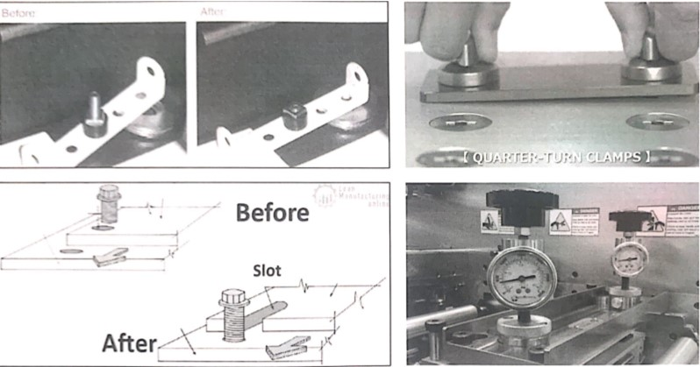
Example

Slide 135
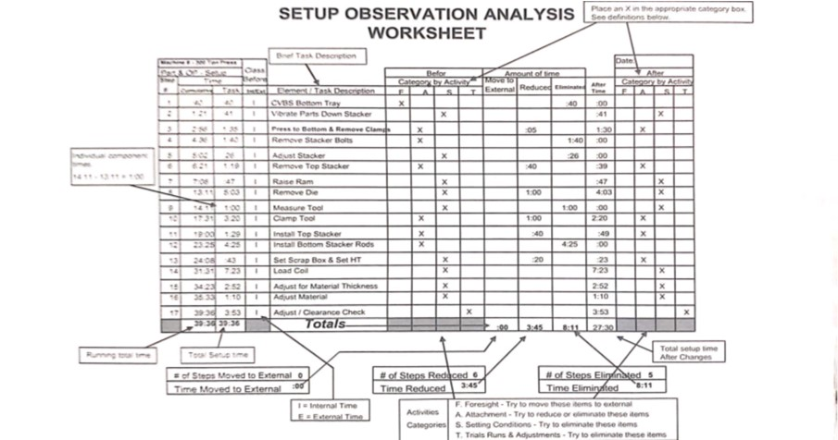
SMED

Slide 136
SMED Benefits
Lower manufacture cost (less equipment downtime)
Smaller lot sizes (faster changeover enable more frequent product changes)
Improved responsiveness to customer demand (smaller lot sizes enable more flexible scheduling)
Lower inventory levels (smaller lot sizes result in lower inventory levels)
Smoother start-ups(Standardized changeover processes improve consistency and quality)

Slide 137
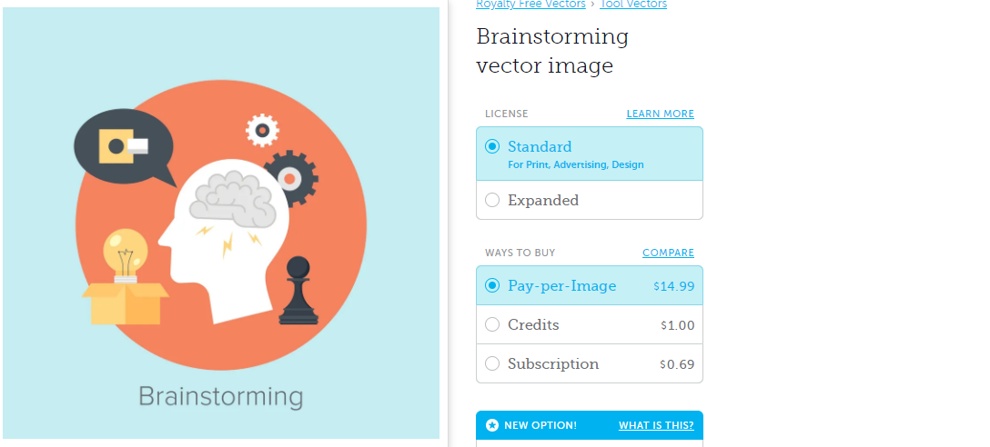
VISUAL CONTROL
Visual control is the use of Signals, Lights, measurement, Diagrams, Charts & Sign to
Clearly define the normal or desired condition
Expose the abnormal undesired condition - real time
Enabling anyone visually
Understanding the current Situation (self-explaining)
Understand the Work Process (Self-ordering)
if You are ahead, behind or on schedule (Self-regulating)
When There is an Abnormality (Self-Improving)

Slide 138
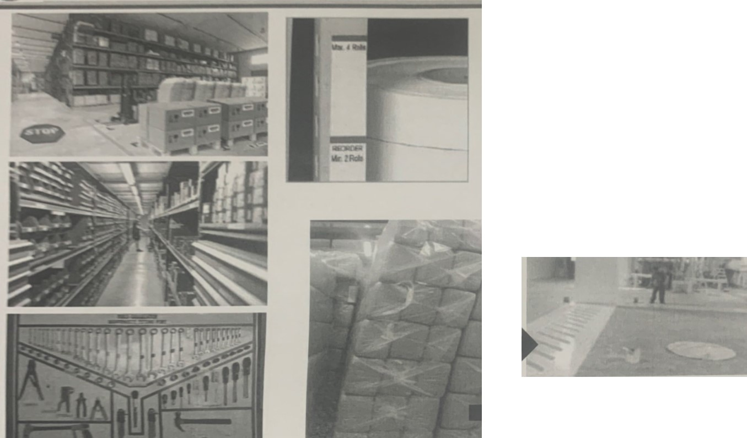
VISUAL CONTROL FUNCTIONALITY
Materials management
To find materials more easily and to return material more easily.
Material stock production level control.

Slide 139
VISUAL CONTROL FUNCTIONALITY
Remind people of safety information, and prevent unsafe condition.

Slide 140
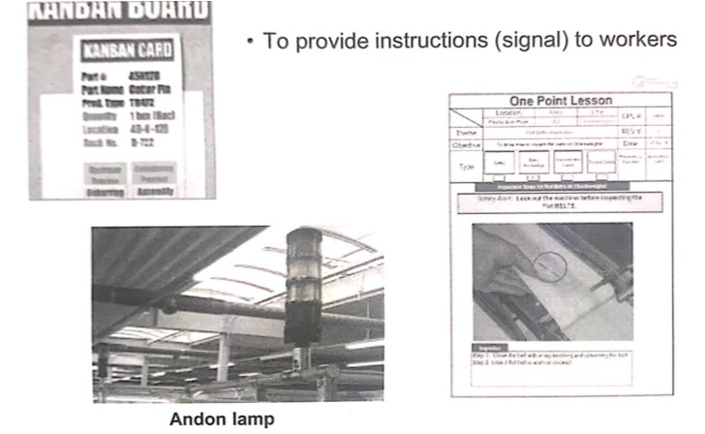
VISUAL CONTROL FUNCTIONALITY

Slide 141
VISUAL CONTROL FUNCTIONALITY
Blue : Project on time
Yellow : Project up to 0.5 hours behind >
current operations need to work faster
Red: Project greater than 0.5 hours behind > manager needs to bring in additional operators to help catch up
To motivate workers to achieve targets & qualities

Slide 142
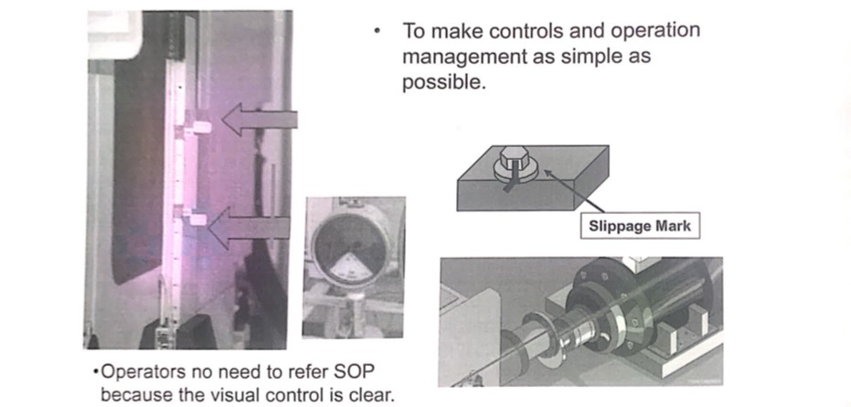
VISUAL CONTROL FUNCTIONALITY

Slide 143
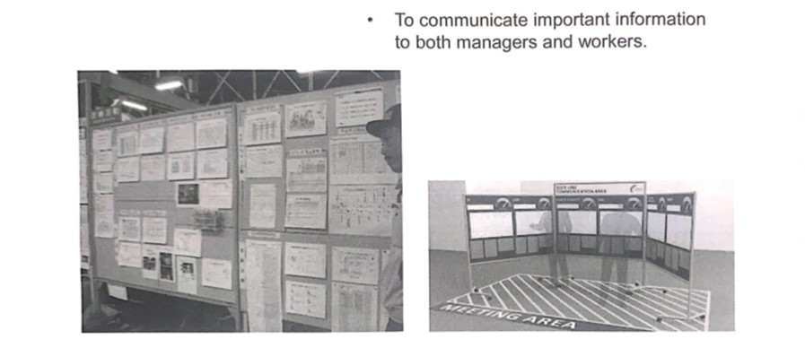
VISUAL CONTROL FUNCTIONALITY

Slide 144
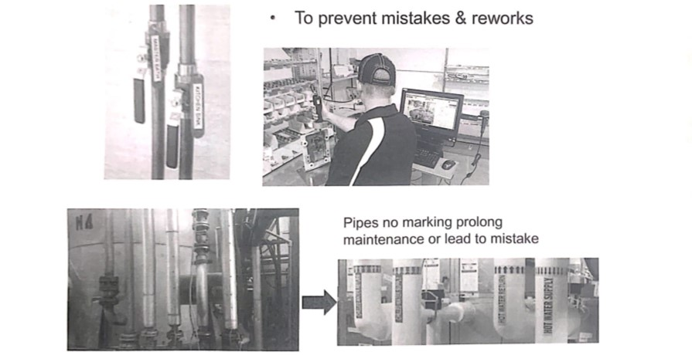
VISUAL CONTROL FUNCTIONALITY

Slide 145
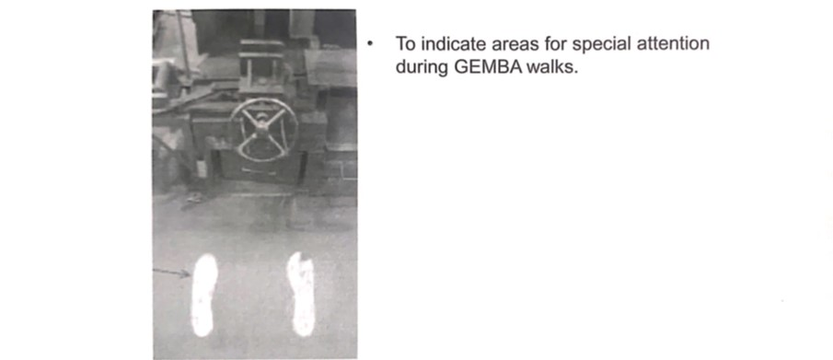
VISUAL CONTROL FUNCTIONALITY

Slide 146
KANBAN
Is an information system that provides a signal to inform the need to start an activity
KAN = "card" BAN = "Signal"
Control of production flow by providing information that connects the upstream and downstream processes at each level
Visualized "pull" system
Control inventory

Slide 147
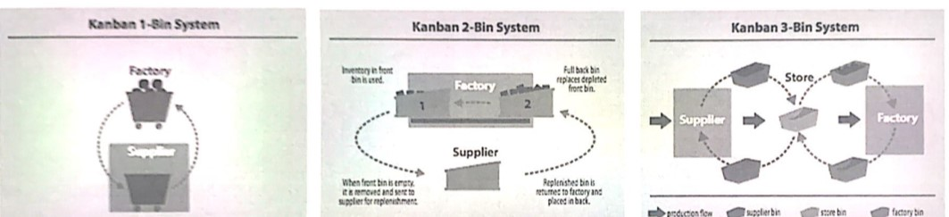
KANBAN – BIN SYSTEM
A system that uses a single bin or card to trigger an action
A 2-bin system is commonly used in storage areas at many types of workplaces.
A 3-bin system connects different departments or different parts of work processes

Slide 148
2 CARD KANBAN
The first Kanban card, which moves between shipping and the store, is often called the withdrawal Kanban card.
The second Kanban card, which moves between the store and the production line, is often called the production Kanban card.

Slide 149
SUPERMARKET
Supermarket
A
B
C
Parts Consuming Process
Parts Producing Process
KANBAN board
Product with attached KANBAN Card
Product manufactured Item
KANBAN Card

Slide 150
OTHER KANBAN
Electronic KANBAN
Barcodes are placed on items, on materials, or in specific locations. These barcodes are scanned when more of something is needed, which sends a signal to the correct person or department to fill the request.

Slide 151
OTHER KANBAN
Floor or Shelf Markings
Some workplaces or storage areas choose to use color- coded floor or shelf markings to indicate when something needs to be produced or ordered.
Green level, nothing needs to happen.
Yellow level, production might begin.
Red level, levels may have gotten too low and steps need to be taken to quickly fix the problem.

Slide 152
OTHER KANBAN
Floor or Shelf Markings
Some workplaces or storage areas choose to use color- coded floor or shelf markings to indicate when something needs to be produced or ordered.
Green level, nothing needs to happen.
Yellow level, production might begin.
Red level, levels may have gotten too low and steps need to be taken to quickly fix the problem.

Slide 153
OTHER KANBAN

Slide 154

ERGONOMIC PRINCIPLE
Is a principle of tracing what work movements are the best, so that humans can work with highest performance and minimum levels of fatigue
Ease of movement of materials related to machines, tools, jigs (work aids), and layouts
Use free anergy such as gravity
Purpose:
Eliminating the causes of errors from work fatigue.
Trying to be able to work in rhythm by eliminating waste in terms of motion.

Slide 155
MINIMIZE OVERALL MOVEMENT (COMBINE TASKS)
No. | Worker Movement
1 | Take Jig B
2 | Put Jig B into Machine
3 | Take Tool B from Rack
4 | Tighten Jig B with Tool B
5 | Put Tool B back on Rack
6 | Tool Jig A
7 | Put Jig A into Machine
8 | Take Tool A From Rack
9 | Put Tool A on machine
10 | Put pin into machine
11 | Take Tool A
12 | Tighten Jig A with Tool A
13 | Put Tool A back on Rack
No. | Worker Movement
1 | Take Jig Set A and B
2 | Put Jig set A and B Into Machine
3 | Take common Tools at machine
4 | Tighten Jig B
5 | Tighten Jig A
6 | Put common tools
Worker-1
13 - > 6

Slide 156
USE BOTH HAND TO HANDLE
No. | Left hand | Right hand
1 | Take Jig set | wait
2 | Put Jig set into machine | wait
3 | wait | Take common tools
4 | wait | Tighten Jig B
5 | wait | Tighten Jig A
6 | Put common tools | wait
No. | Left hand | Right hand
1 | Take Jig set | Put comman t
2 | Put Jig set into machine | Tighten Jig B
3 | wait | Tighten Jig A
4 | wait | Release common tools
Worker-1
Worker-1

Slide 157
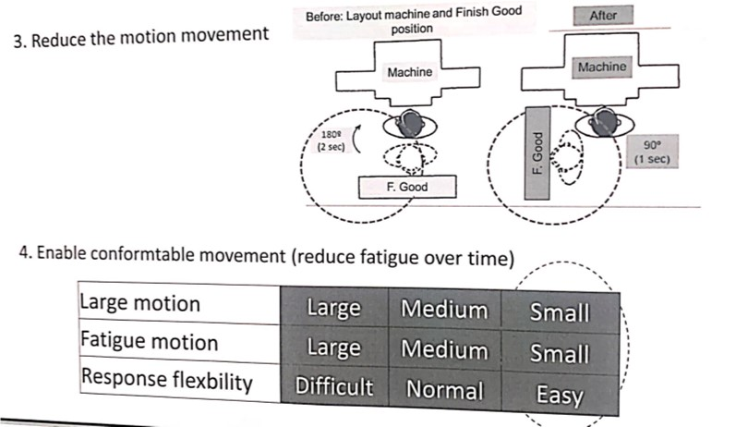
ERGONOMIC PRINCIPLE

Slide 158
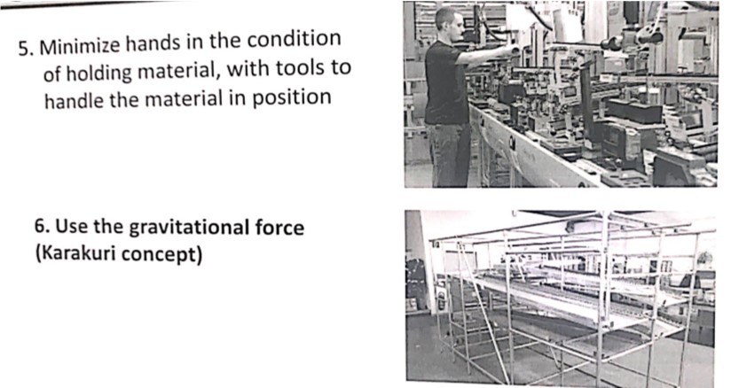
ERGONOMIC PRINCIPLE

Slide 159

ERGONOMIC PRINCIPLE

Slide 160

STANDARD WORK

Slide 161

STANDARD WORK

Slide 162

STANDARD WORK

Slide 163

3 ELEMENTS OF STANDARD WORK

Slide 164

EXAMPLE OF STANDARD WORK

Slide 165

EXAMPLE OF STANDARD WORK

Slide 166

CONTROL MECHANISM

Slide 167

LAT Summary

Slide 168

LAT Summary

Slide 169



